Slide 1
Light Painting
ME547 – Final Project
Atakan Efe Kanman
Ahmed Syed
Jasdeep Dhillon

Slide 2
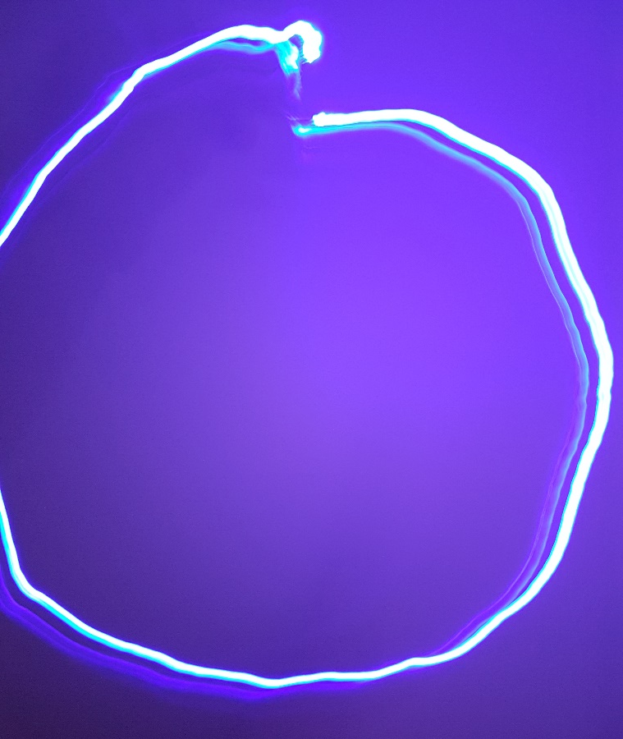
Problem Definition
Light painting
Capturing light trails using long exposure photography
Drawing images in air
Requires some method of moving light source
Hard to do by hand (cannot see trail with eyes)

Slide 3
Objective
Create and communicate a desired path to the robot
Recreate path with robot’s end effector

Slide 4
Main Tasks
Receive path from user
Map path to robot’s workspace
Send path waypoints to robot
Capture long exposure photo of movement

Slide 5
Flow Diagram
Path Generation
Path Recreation
Start
Detect coloured object
Read text file
Find center in pixels
Map coordinate to robot workspace
Store (x,y) in array as % of picture dimension
Get robot parameters through inverse kinematics
Complete?
Send command to robot
NO
End of file?
YES
NO
Write array to text file
End
YES

Slide 6
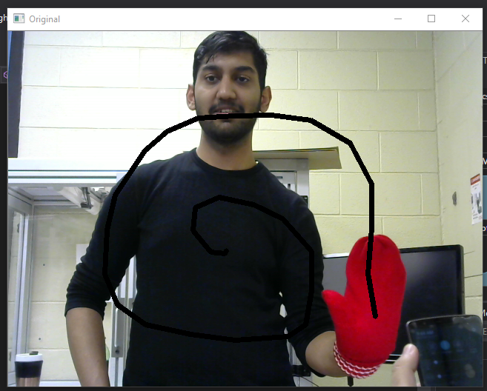
Path Generation
Computer vision based detection
OpenCV
Personal computer
Main Steps:
Capture video frame from webcam
Detect specific colour and mask image
Find center of masked object
Draw line from previous point to new point

Slide 7
Path Generation - continued
Detecting object
Find all pixels with desired HSV values
Hue: 147-179 (red)
Saturation/Value: Depend on lighting

Slide 8
Detecting Red Mitt
Video here

Slide 9
Path Generation - continued
Find center of masked image
Draw line from current center to previous center
Store position as a percentage of picture dimensions
X = x / width
Y = y/ height
(0,0)
(x,y)

Slide 10
Tracking Center
Video here

Slide 11
Mapping Points to Robot Workspace
The origin of the robot space and captured image do not align
Image: top left
Robot: bottom right
X = maxX – (x)(x-range); Z = maxZ – (z)(z-range);
(0,0)
(max X, max Z)
z
(640,480)
x
Image
Workspace

Slide 12
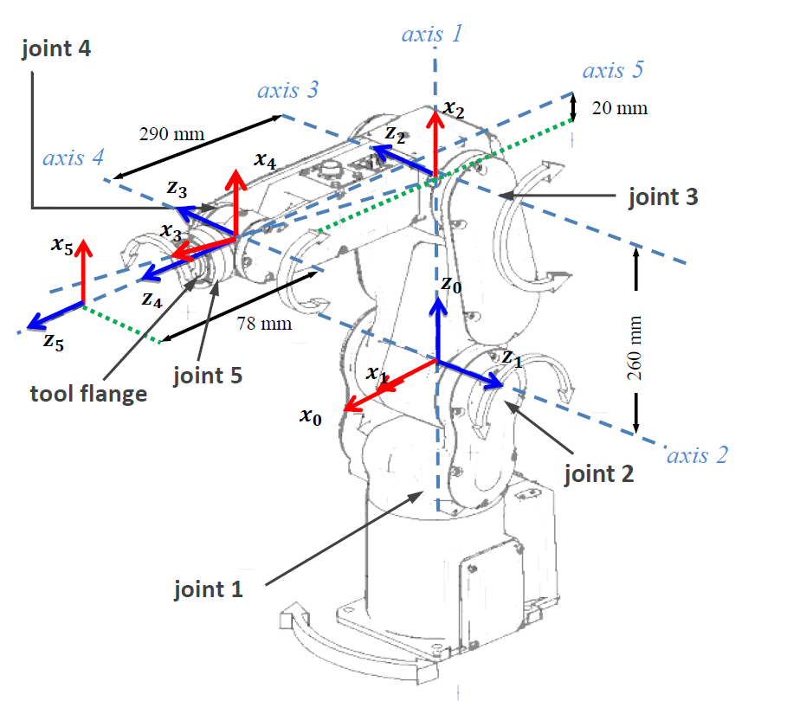
DH Table
i | a_{i} | α_{i} | d_{i} | θ_{i}
1 | 0 | -90 | 0 | θ₁
2 | 260 | 180 | 0 | $${ θ}_{2}$$
3 | 290.07 | 0 | 0 | $${ θ}_{3}$$
4 | 0 | 90 | 0 | θ₄
5 | 0 | 0 | 73 | θ₅

Slide 13
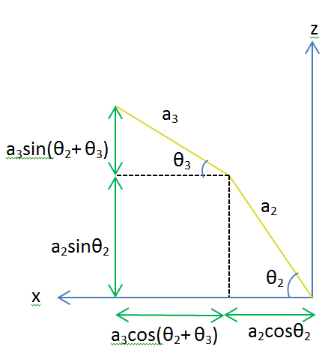
Inverse Kinematics
Purpose: Move light source to points along the path drawn by the user
x_{c} = 480 - (x * 240)
y_{c} = 0
z_{c} = 250 - (z * 180)
$$d=\frac{x_{c}^{2}+y_{c}^{2}−a_{2}^{2}−a_{3}^{2}}{2a_{2}a_{3}}$$

Slide 14
Inverse Kinematic Results
θ₁ = 0
$θ_{2}=Atan2\left(z_{c},x_{c}\right)−Atan2\left(a_{3}sinθ_{3},a_{2}+a_{3}cosθ_{3}\right)$
$θ_{3}=Atan2(±\sqrt{1−D^{2}},D)$
θ₄ = 0
θ₅ = 0

Slide 15
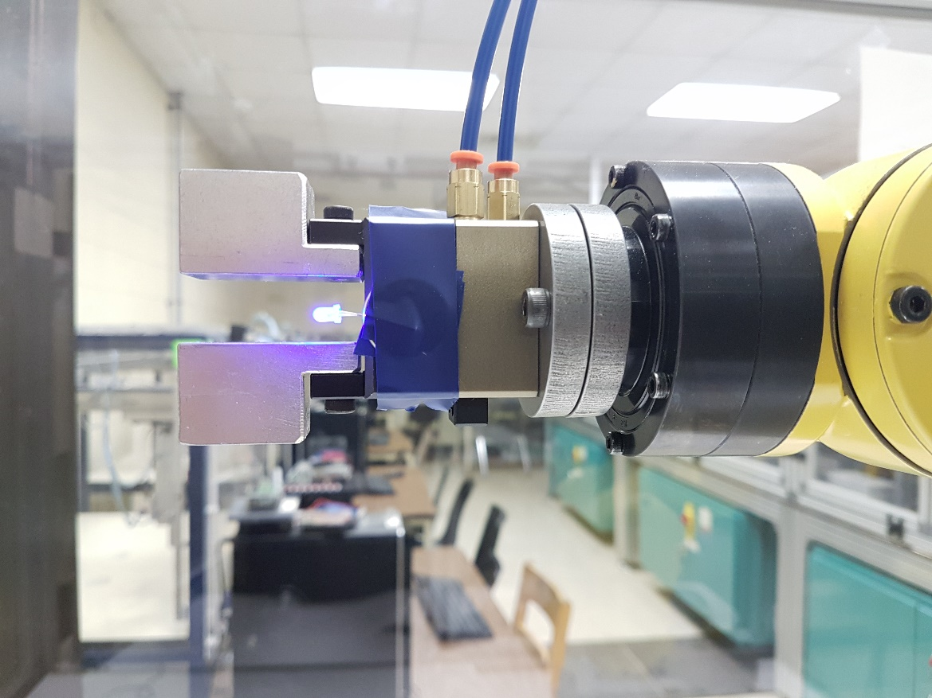
Testing
Attach 3mm LED to end effector
Take long exposure photo with smartphone
Max exposure time of 10 seconds

Slide 16
Videos here

Slide 17
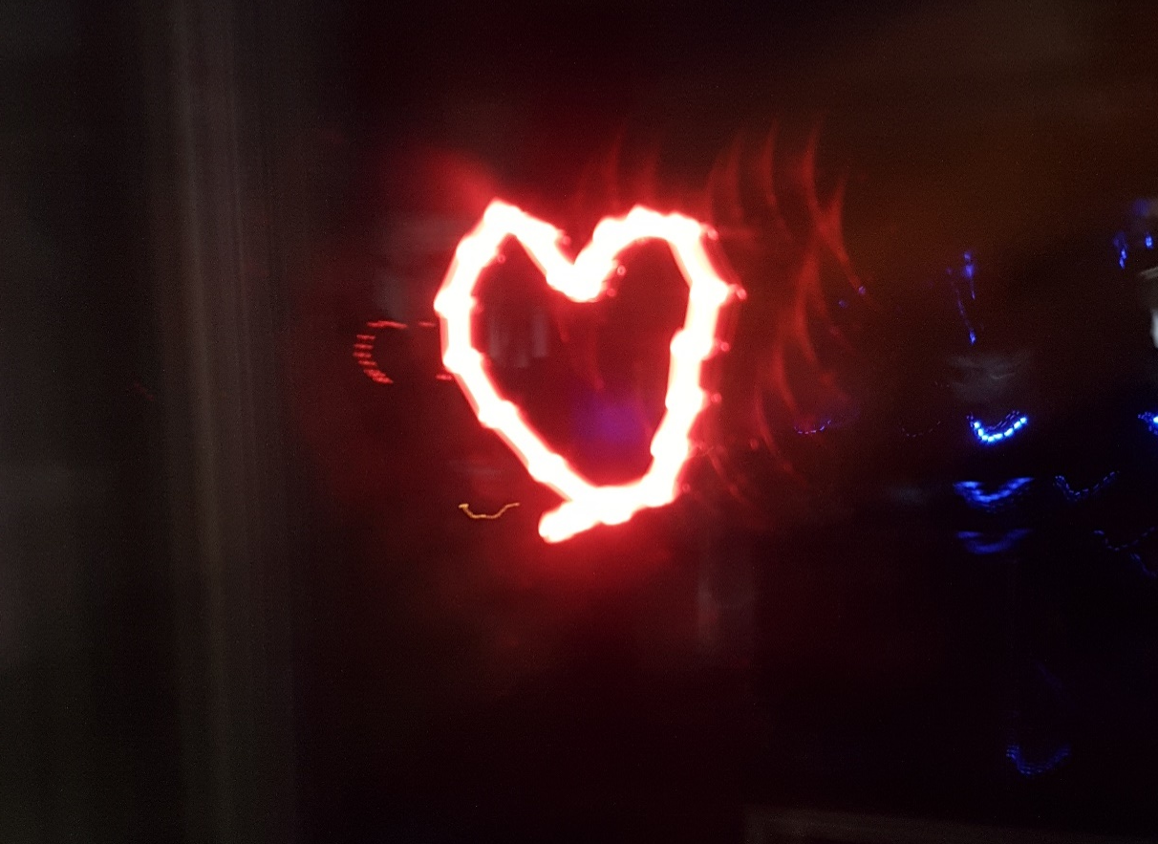
Results

Slide 18
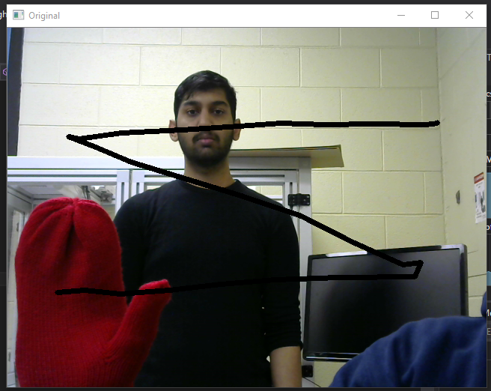

Slide 19
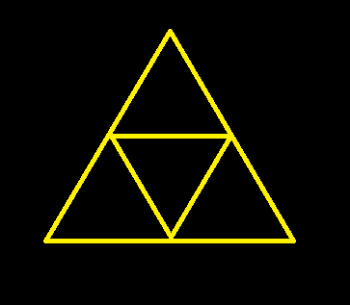

Slide 20
Conclusion
Completed both objectives
Able to track object and define a path
Able to follow path to recreate image
Resulting images were skewed
Did not follow path perfectly
Improvements:
Increase number of waypoints for smoother curves
Better camera with longer exposure time
Allow larger workspace to reduce scaling

